Slide 1
PASSIVE VOICE PRESENT SIMPLE AND PAST SIMPLE
TRPNIK V NAVADNEM SEDANJIKU IN NAVADNEM PRETEKLIKU

Slide 2
Most often we use sentences in ACTIVE VOICE (tvornik).
The PASSIVE VOICE (trpnik) is used when we focus on the object of the sentence.
The passive is a grammatical voice that moves an object of a sentence in the active voice into the subject position.

Slide 3
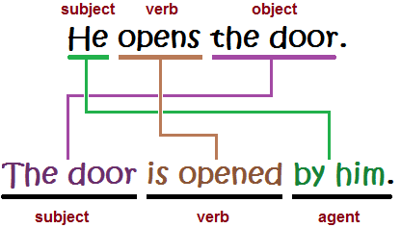
PASSIVE VOICE, PRESENT SIMPLE BE (am, is, are) + past participle (3. obl. Gl.)
TENSE | ACTIVE VOICE | PASSIVE VOICE
PRESENT SIMPLE | The teacher punishes me. The teacher punishes the boy. The teacher punishes the boys. | I am punished by the teacher. The boy is punished by the teacher. The boys are punished by the teacher.

Slide 4
PASSIVE VOICE, past simple BE (was,were) + past participle (3. obl. Gl.)
TENSE | ACTIVE VOICE | PASSIVE VOICE
PAST SIMPLE | The teacher punished me. The teacher punished the boys. | I was punished by the teacher. The boys were punished by the teacher.

Slide 5
passive voice, Present simple – examples:
In the passive voice sentence we express the doer of the action at the end of the sentence by using the „by + pronoun“ phrase.

Slide 6
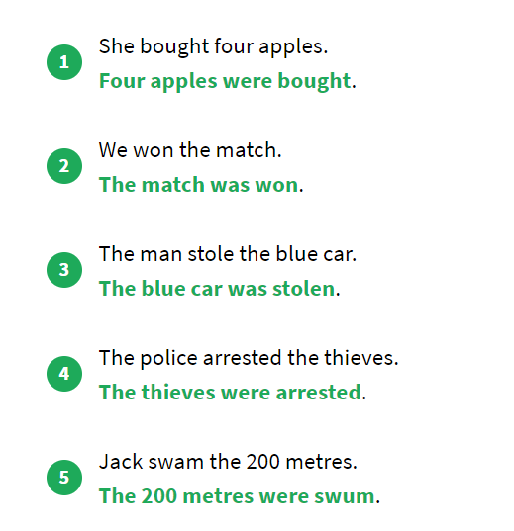
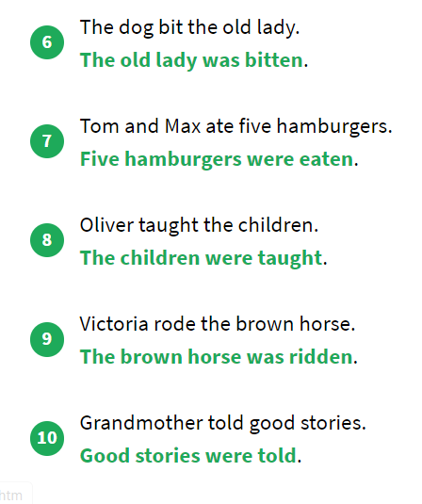
PASSIVE VOICE, PAST SIMPLE – EXAMPLES:

Slide 7
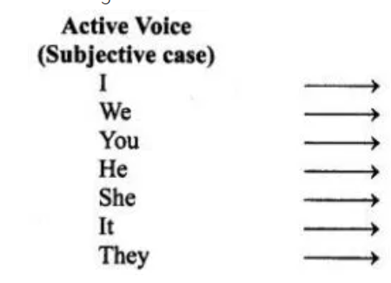
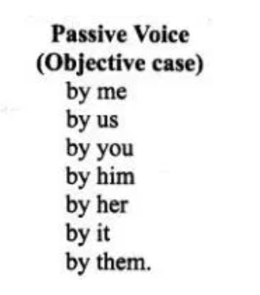
The change of „SUBJECT“ PRONOUN to „OBJECT“ PRONOUN
from ACTIVE to PASSIVE VOICE:

Slide 8
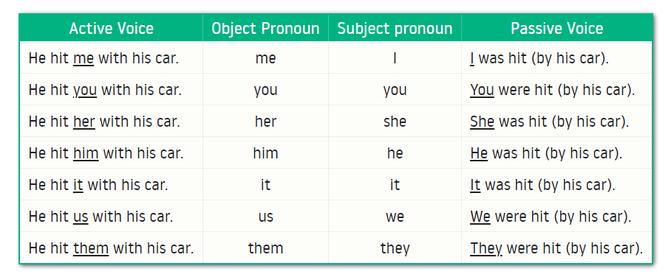

Slide 9
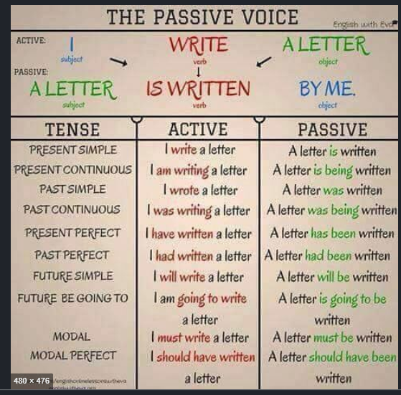
PASSIVE VOICE IN OTHER TENSES (be + past participle)

